Slide 1
Modernizing Academic Server Administration with Infrastructure as Code & Ansible
A practical approach to automate, secure, and simplify campus IT management
Sreepathy, MSIS,MAHE,Manipal

Slide 2
Table of Contents:
Introduction & Current Challenges
What is Infrastructure as Code (IaC)?
Configuration Management with Ansible
Ansible Architecture & Components
How Academia Benefits
Demo Summary
Q&A

Slide 3
Current Challenges in Academia
Manual server setup is slow and error-prone
Inconsistent configurations across labs and departments
High dependency on few skilled admins
Security patches are hard to enforce
Poor documentation causes handover issues

Slide 4
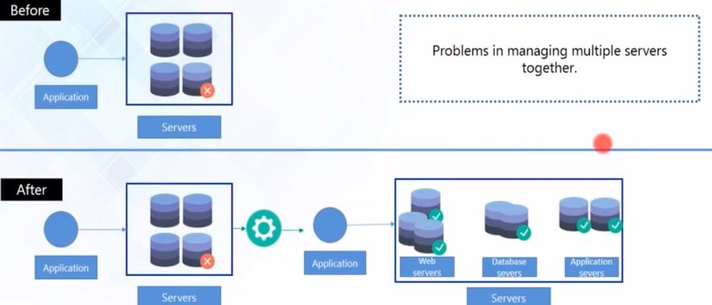
Current Challenges in Server Administration

Slide 5
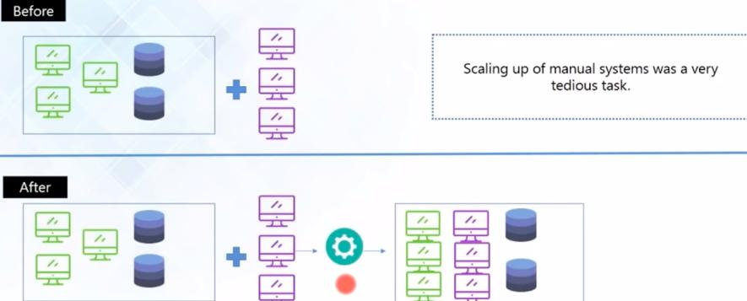
Current Challenges in Server Administration

Slide 6
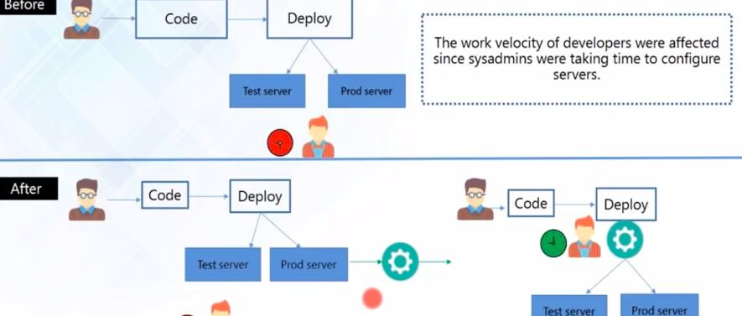
Current Challenges in Server Administration

Slide 7
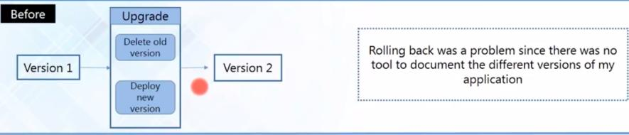
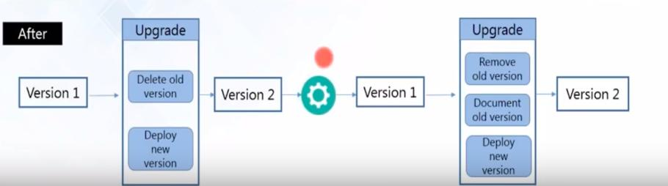
Current Challenges in Server Administration

Slide 8
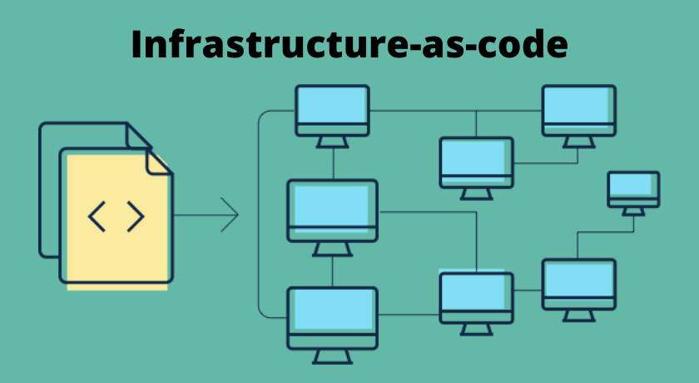
What is IaC?

Slide 9
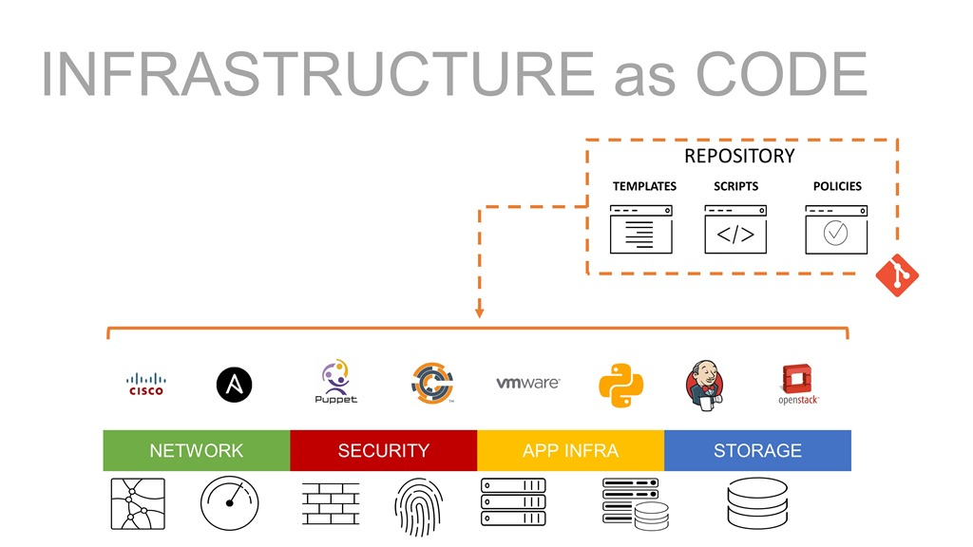
What is IaC?

Slide 10
What is IaC?
IaC is the practice of managing and provisioning computing infrastructure using machine-readable configuration files instead of manual processes.
Benefits:
Automate server setup and software deployment.
Achieve consistent, repeatable environments.
Version control for infrastructure (track changes like code).
Easy rollback and recovery.
Save time — focus on teaching & research, not tedious configs.

Slide 11
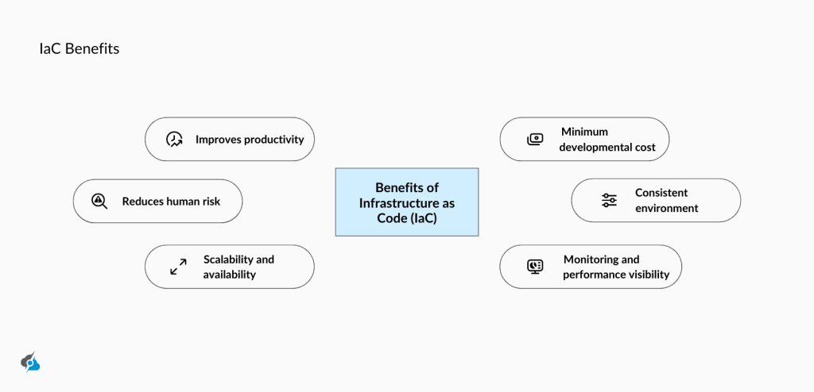
What is IaC?
IaC is the practice of managing and provisioning computing infrastructure using machine-readable configuration files instead of manual processes.

Slide 12
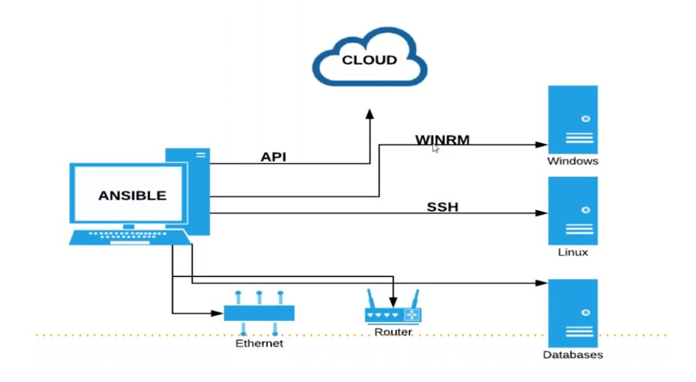
What is Configuration Management?
Definition: It is a subset of IaC focused on maintaining the desired state of servers and software over time.
Examples of tasks:
Install software (IDEs, databases, lab tools).
Enforce security policies.
Apply updates automatically.
Manage multiple OS (Windows, Linux) centrally.
Popular tools:Ansible, Puppet, Chef, SaltStack.

Slide 13
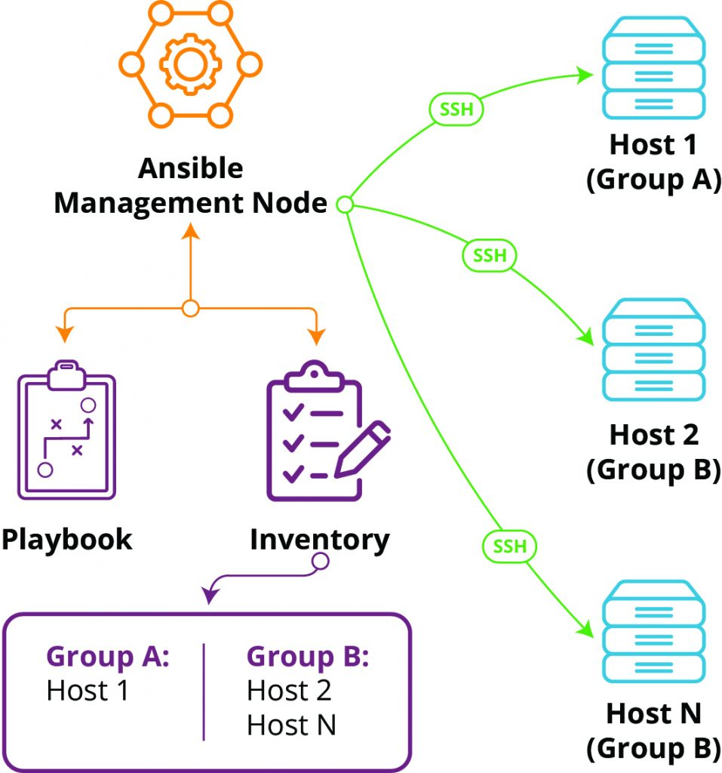
Configuration Management

Slide 14
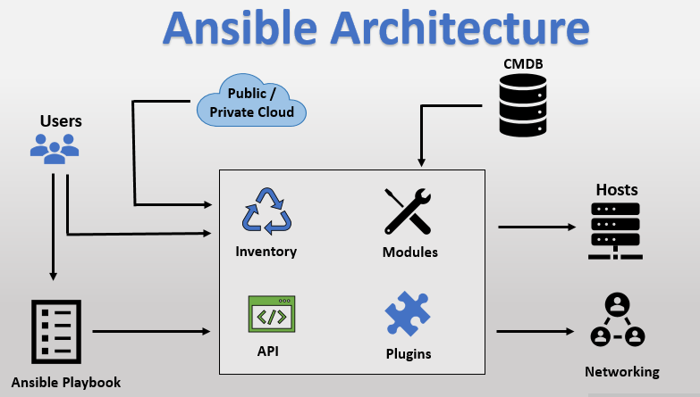
Ansible Architecture

Slide 15
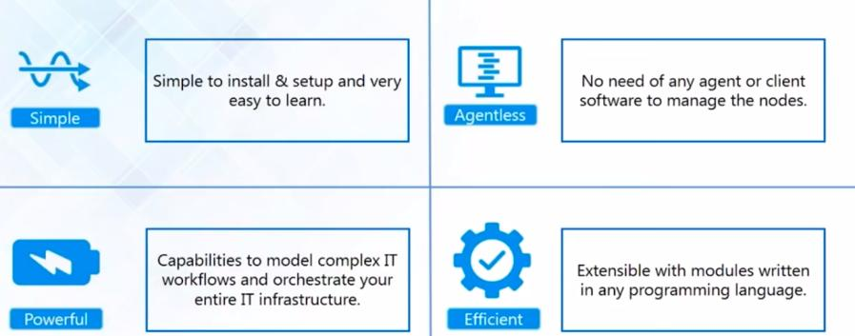
Why Ansible for Academia?

Slide 16
Why Ansible for Academia?
Agentless: No extra software needed on client machines.
Uses SSH (Linux) or WinRM (Windows).
Human-readable playbooks in YAML.
Easy to learn — perfect for academic IT teams.
Large open-source community and reusable roles.

Slide 17
Benefits for Academia from Ansible
Automate lab setup each semester
Quick rebuilds for new courses
Standardized, secure environments
Less manual errors
Better onboarding for new admins

Slide 18
Demo Overview

Slide 19
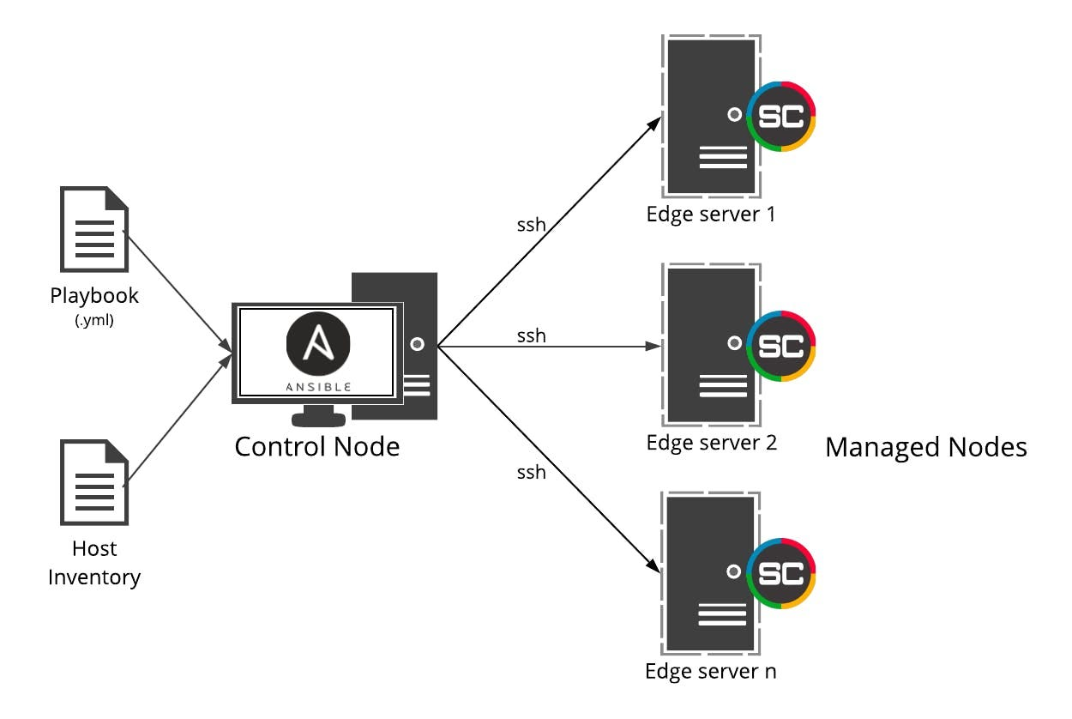
Demo Overview

Slide 20
Demo Overview
Installed VSCode, Notepad++, MySQL Workbench on Windows
Same method works for Ubuntu labs
One playbook, many nodes
Easy to repeat and rollback

